Slide 1
Vector Projections

Slide 2
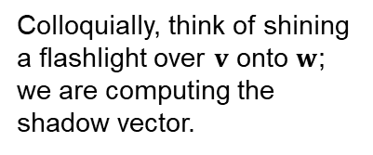
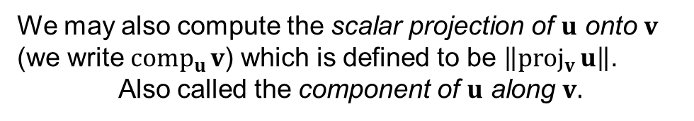

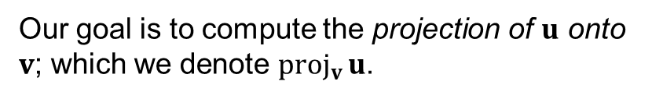




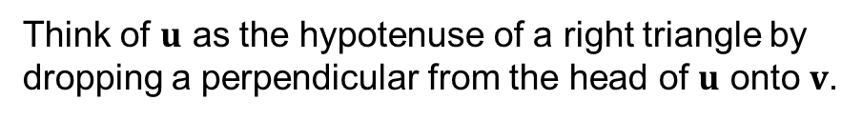

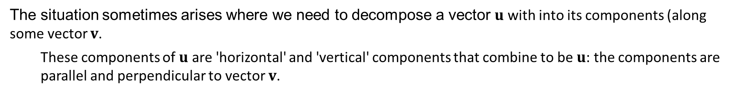


Vector Projections
The situation sometimes arises where we need to decompose a vector $u$ with into its components (along some vector $v$.
These components of $u$ are 'horizontal' and 'vertical' components that combine to be $u$: the components are parallel and perpendicular to vector $v$.
Think of $u$ as the hypotenuse of a right triangle by dropping a perpendicular from the head of $u$ onto $v$.
$$u$$
$$θ$$
$$v$$
Our goal is to compute the projection of $u$ onto $v$; which we denote ${proj}_{v}{u}$.
$${proj}_{v}{u}$$
Colloquially, think of shining a flashlight over $v$ onto $w$; we are computing the shadow vector.
We may also compute the scalar projection of $u$ onto $v$ (we write ${comp}_{u}{v}$) which is defined to be $\left\|{proj}_{v}{u}\right\|$.
Also called the component of $u$ along $v.$
$$u$$
$$θ$$
$$v$$
$${proj}_{v}{u}$$

Slide 3



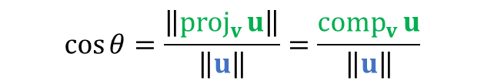

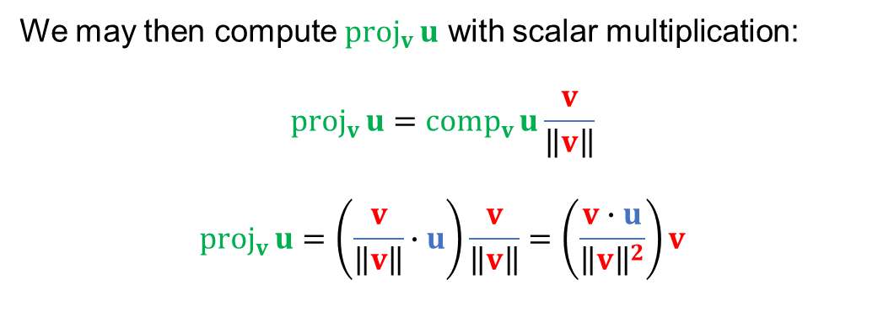

Vector Projection
We may derive the formula for vector projection using right-triangle trigonometry.
$$u$$
$$\cos{θ=\frac{\left\|{proj}_{v}{u}\right\|}{\left\|u\right\|}=\frac{{comp}_{v}{u}}{\left\|u\right\|}}$$
$$θ$$
$$v$$
$${proj}_{v}{u}$$
Thus, $\left\|u\right\|cos{θ={comp}_{v}{u}}$.
Recall the formula for dot product, $u∙v=\left\|u\right\|\left\|v\right\|\cos{θ}$.
Hence, $u∙v=\left\|v\right\|{comp}_{v}{u}$.
We may then compute ${proj}_{v}{u}$ with scalar multiplication:
$${proj}_{v}{u}={comp}_{v}{u}\frac{v}{\left\|v\right\|}$$
$${proj}_{v}{u}=\left(\frac{v}{\left\|v\right\|}∙u\right)\frac{v}{\left\|v\right\|}=\left(\frac{v∙u}{{\left\|v\right\|}^{2}}\right)v$$
Thus, ${comp}_{v}{u}=\frac{v}{\left\|v\right\|}∙u$.
unit vector

Slide 4
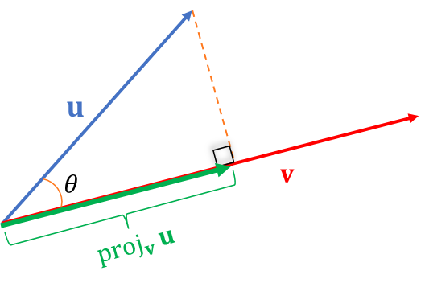



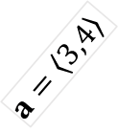
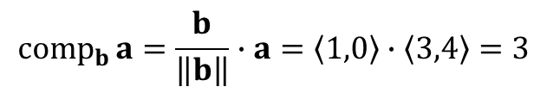

$${comp}_{v}{u}=\frac{v}{\left\|v\right\|}∙u$$
Vector Projection: Example I
$${proj}_{v}{u}={comp}_{v}{u}\frac{v}{\left\|v\right\|}$$
Find the scalar projection and vector projection of $a=\left\langle 3,4\right\rangle$ onto $b=\left\langle 10,0\right\rangle$.
Solution.
$$a=\left\langle 3,4\right\rangle$$
$$b=\left\langle 10, 0\right\rangle$$
We observe graphically that ${comp}_{b}{a}$ is 3 (since $b$ is horizontal). We compute the scalar and vector projections:
$${comp}_{b}{a}=\frac{b}{\left\|b\right\|}∙a=\left\langle 1,0\right\rangle ∙\left\langle 3,4\right\rangle =3$$
Thus, ${proj}_{b}{a}={comp}_{b}{a}\frac{b}{\left\|b\right\|}=3\left\langle 1,0\right\rangle =\left\langle 3,0\right\rangle$.

Slide 5
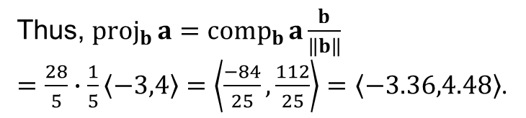

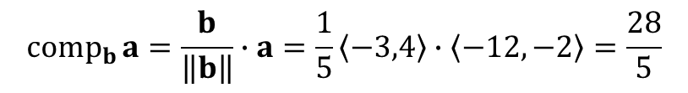
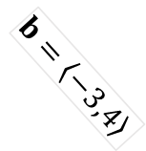
$${comp}_{v}{u}=\frac{v}{\left\|v\right\|}∙u$$
Vector Projection: Example II
$${proj}_{v}{u}={comp}_{v}{u}\frac{v}{\left\|v\right\|}$$
Find the vector projection of $a=\left\langle −12,−2\right\rangle$ onto $b=\left\langle −3,4\right\rangle$.
Solution.
$$b=\left\langle −3,4\right\rangle$$
$$a=\left\langle −12,−2\right\rangle$$
Thus, ${proj}_{b}{a}={comp}_{b}{a}\frac{b}{\left\|b\right\|}$
$=\frac{28}{5}∙\frac{1}{5}\left\langle −3,4\right\rangle =\left\langle \frac{−84}{25},\frac{112}{25}\right\rangle =\left\langle −3.36,4.48\right\rangle$.
$${comp}_{b}{a}=\frac{b}{\left\|b\right\|}∙a=\frac{1}{5}\left\langle −3,4\right\rangle ∙\left\langle −12,−2\right\rangle =\frac{28}{5}$$
Note that a scalar projection with a positive value indicates a vector projection in the same direction as the vector we are projecting onto.

Slide 6
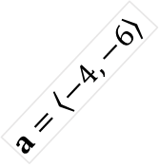
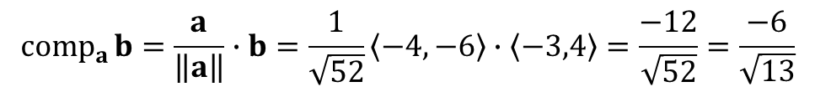

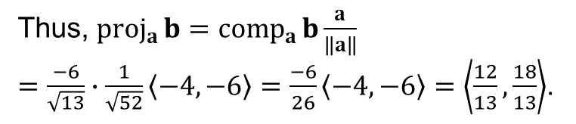
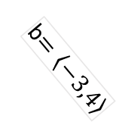
$${comp}_{v}{u}=\frac{v}{\left\|v\right\|}∙u$$
Vector Projection: Example III
$${proj}_{v}{u}={comp}_{v}{u}\frac{v}{\left\|v\right\|}$$
Find the vector projection of $b=\left\langle −3,4\right\rangle$ onto $a=\left\langle −4,−6\right\rangle$.
Solution.
b$=\left\langle −3,4\right\rangle$
$$a=\left\langle −4,−6\right\rangle$$
Thus, ${proj}_{a}{b}={comp}_{a}{b}\frac{a}{\left\|a\right\|}$
$=\frac{−6}{\sqrt{13}}∙\frac{1}{\sqrt{52}}\left\langle −4,−6\right\rangle =\frac{−6}{26}\left\langle −4,−6\right\rangle =\left\langle \frac{12}{13},\frac{18}{13}\right\rangle$.
$${comp}_{a}{b}=\frac{a}{\left\|a\right\|}∙b=\frac{1}{\sqrt{52}}\left\langle −4,−6\right\rangle ∙\left\langle −3,4\right\rangle =\frac{−12}{\sqrt{52}}=\frac{−6}{\sqrt{13}}$$
Note that a scalar projection with a negative value indicates a vector projection in the opposite direction as the vector we are projecting onto.
As an exercise, compute ${proj}_{a}{b}={proj}_{−a}{b}=\left\langle \frac{12}{13},\frac{18}{13}\right\rangle$.

Slide 7
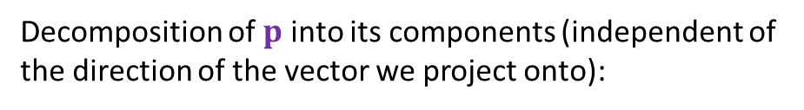




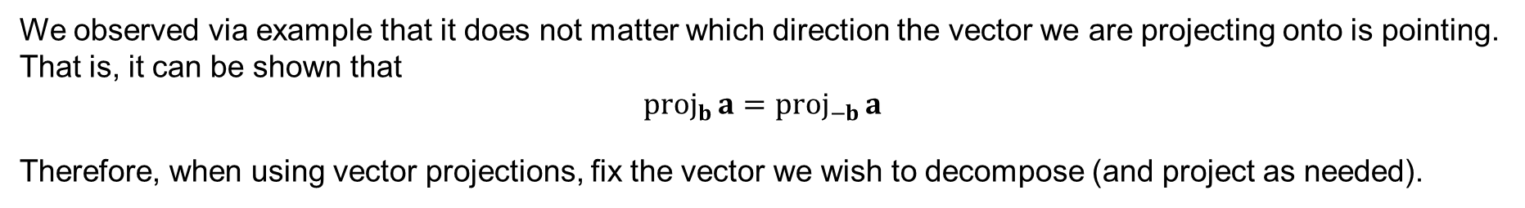







An Observation
We observed via example that it does not matter which direction the vector we are projecting onto is pointing. That is, it can be shown that
$${proj}_{b}{a}={proj}_{−b}{a}$$
Therefore, when using vector projections, fix the vector we wish to decompose (and project as needed).
$$p$$
Decomposition of $p$ into its components (independent of the direction of the vector we project onto):
$${proj}_{v}{p }$$
$$p$$
$$g$$
$${proj}_{v}{p }$$
$${proj}_{g}{p }$$
$${proj}_{g}{p }$$
$$p={proj}_{g}{p }+{proj}_{v}{p }$$
$$g$$
$$v$$
$$v$$

Slide 8
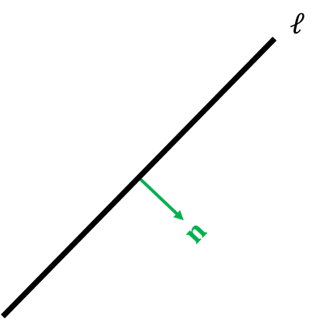
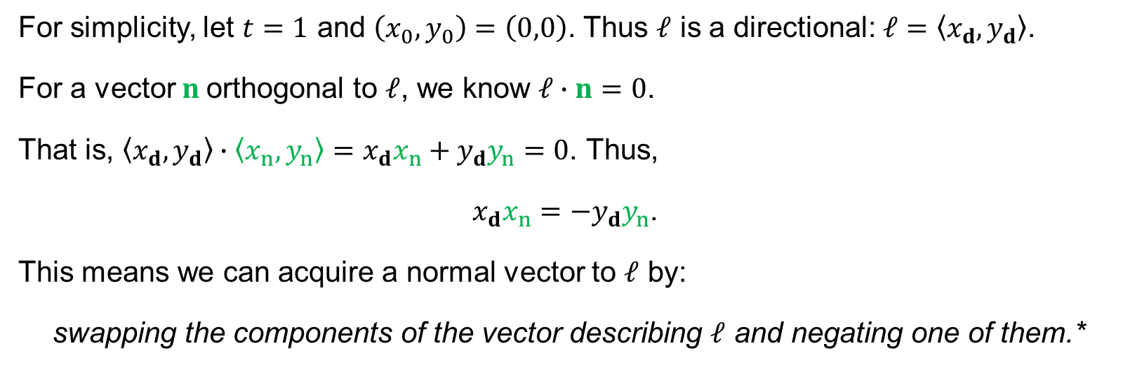
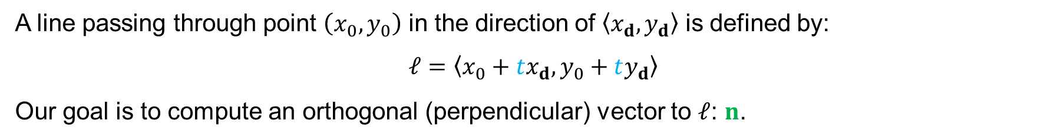

Recall: Computing a Normal Vector
A line passing through point $\left(x_{0},y_{0}\right)$ in the direction of $\left\langle x_{d}, y_{d}\right\rangle$ is defined by:
$$ℓ=\left\langle x_{0}+tx_{d},y_{0}+ty_{d}\right\rangle$$
Our goal is to compute an orthogonal (perpendicular) vector to $ℓ$: $n$.
We call $n$ a normal vector.
For simplicity, let $t=1$ and $\left(x_{0},y_{0}\right)=\left(0,0\right)$. Thus $ℓ$ is a directional: $ℓ=\left\langle x_{d},y_{d}\right\rangle$.
For a vector $n$orthogonal to $ℓ$, we know $ℓ∙n=0$.
That is, $\left\langle x_{d},y_{d}\right\rangle ∙\left\langle x_{n},y_{n}\right\rangle =x_{d}x_{n}+y_{d}y_{n}=0\text{.}$Thus,
$x_{d}x_{n}=−y_{d}y_{n}$.
This means we can acquire a normal vector to $ℓ$ by:
swapping the components of the vector describing $ℓ$ and negating one of them.*
*This does not work if we are dealing with the zero vector.

Slide 9








Job Interview Question: Shortest Distance from Point to a Line
Let $ℓ$ be a plane and P be a point. Compute the distance between P and $ℓ$.
The distance between a point and a line is defined by the shortest distance from P to $ℓ$; our goal is to find the perpendicular from P to $ℓ$.
$$P$$
Identify a point on $ℓ$. Call it L.
$$n$$
$$ℓ$$
Draw a vector $v$ from L to P (or P to L).
$$v$$
Compute a normal $n$ to $ℓ$.
Compute the component $v$onto $n$ (magnitude of ${proj}_{n}{v}$).
$$L$$

Slide 10
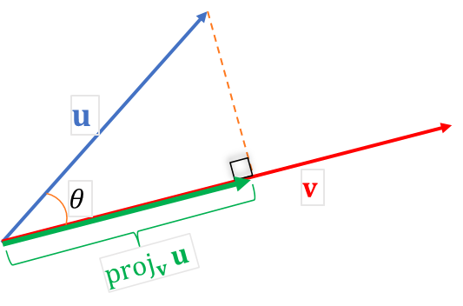
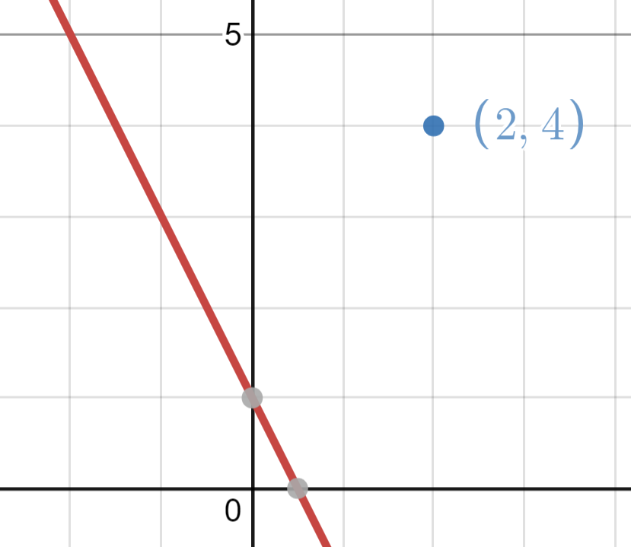



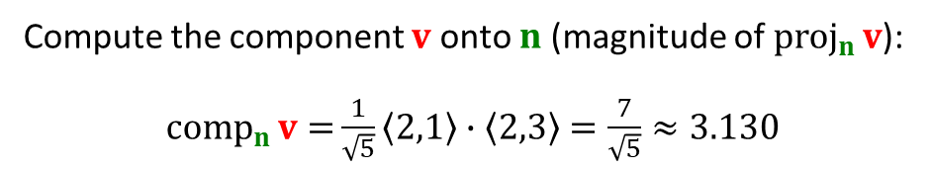


Shortest Distance from Point to a Line: Example
$${comp}_{v}{u}=\frac{v}{\left\|v\right\|}∙u$$
Compute the shortest distance from the line $2x + y = 1$ and the point $(2, 4)$.
Define $ℓ$as a vector: $ℓ=\left\langle −1,2\right\rangle$ as well as a corresponding normal $n=\left\langle 2,1\right\rangle$.
We choose a point on $ℓ$: $\left(0, 1\right)$.
Define $v=\left\langle 2−0, 4−1\right\rangle =\left\langle 2, 3\right\rangle$
Compute the component $v$onto $n$ (magnitude of ${proj}_{n}{v}$):
${comp}_{n}{v=}\frac{1}{\sqrt{5}}\left\langle 2,1\right\rangle ∙\left\langle 2,3\right\rangle =\frac{7}{\sqrt{5}}≈3.130$
$$n$$
$$ℓ$$

Slide 11



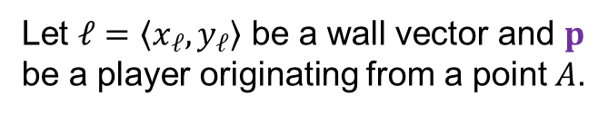


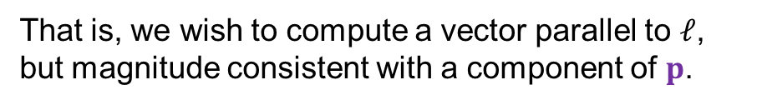


Wall Collision: Component Acquisition
Assume you are mad at a wall in a videogame and you really want to walk through it. How can we force a character to move parallel to a wall (and not through it)?
We wish to accomplish two things:
Move the player according to the magnitude of the player vector.
Zero out any magnitude into the wall.
Let $ℓ=\left\langle x_{ℓ},y_{ℓ}\right\rangle$ be a wall vector and $p$ be a player originating from a point $A$.
That is, we wish to compute a vector parallel to $ℓ$, but magnitude consistent with a component of $p$.
$${proj}_{ℓ}{p}$$
$$A$$
We project $p$ onto $ℓ$:
${comp}_{ℓ}{p}=\frac{ℓ}{\left\|ℓ\right\|}∙p$ ${proj}_{ℓ}{p}={comp}_{ℓ}{p}\frac{ℓ}{\left\|ℓ\right\|}$
$$p$$
$$ℓ$$
$$r$$
Our desired vector for player movement is then given by:
$$r=A+{proj}_{ℓ}{p}$$

Slide 12
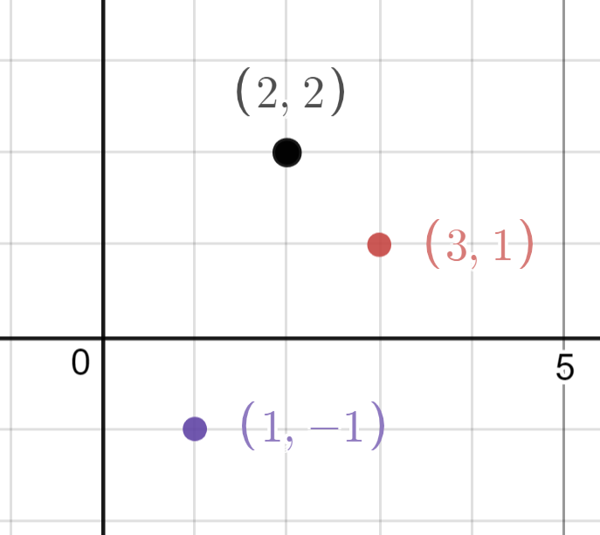

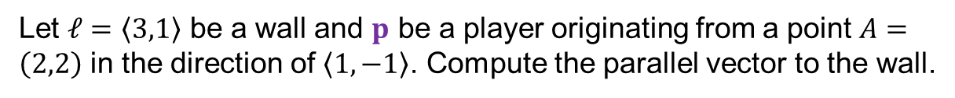
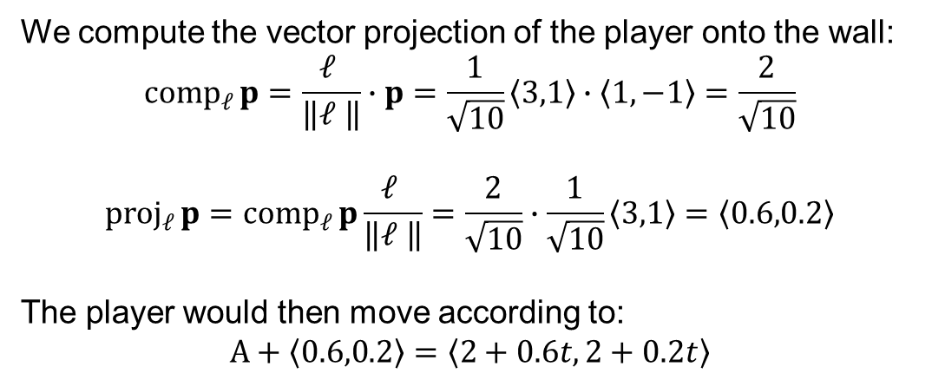



Wall Collision: Example
$${comp}_{v}{u}=\frac{v}{\left\|v\right\|}∙u$$
$${proj}_{v}{u}={comp}_{v}{u}\frac{v}{\left\|v\right\|}$$
Let $ℓ=\left\langle 3,1\right\rangle$ be a wall and $p$ be a player originating from a point $A=\left(2,2\right)$ in the direction of $\left\langle 1,−1\right\rangle$. Compute the parallel vector to the wall.
Solution.
We compute the vector projection of the player onto the wall:
$${comp}_{ℓ}{p}=\frac{ℓ }{\left\|ℓ \right\|}∙p=\frac{1}{\sqrt{10}}\left\langle 3,1\right\rangle ∙\left\langle 1,−1\right\rangle =\frac{2}{\sqrt{10}}$$
$${proj}_{ℓ}{p}={comp}_{ℓ}{p}\frac{ℓ }{\left\|ℓ \right\|}=\frac{2}{\sqrt{10}}∙\frac{1}{\sqrt{10}}\left\langle 3,1\right\rangle =\left\langle 0.6,0.2\right\rangle$$
The player would then move according to:
$$A+\left\langle 0.6,0.2\right\rangle =\left\langle 2+0.6t,2+0.2t\right\rangle$$
$$ℓ$$
$$p$$

Slide 13

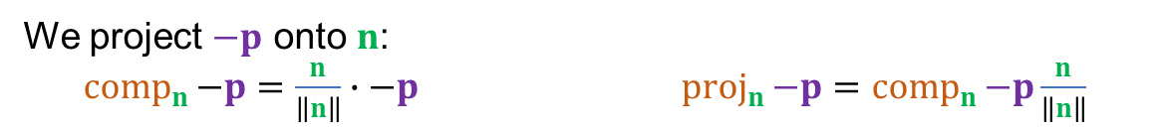







Wall Collision: Component Acquisition (Revisited)
Let $ℓ=\left\langle x_{ℓ},y_{ℓ}\right\rangle$ be a wall vector and $p$ be a player originating from a point $A$.
We compute a normal vector $n$ that is orthogonal to $ℓ$.
We project $−p$ onto $n$:
${comp}_{n}{−p}=\frac{n}{\left\|n\right\|}∙−p$ ${proj}_{n}{−p}={comp}_{n}{−p}\frac{n}{\left\|n\right\|}$
$$A$$
$$p$$
$$r$$
Our desired vector for player movement is then given by:
$$ℓ$$
$$n$$
$${proj}_{n}{−p}$$
$$r=A+p+{proj}_{n}{−p}=A+p−{proj}_{n}{p}$$
Note: ${proj}_{b}{−a}=−{proj}_{b}{a}$

Slide 14
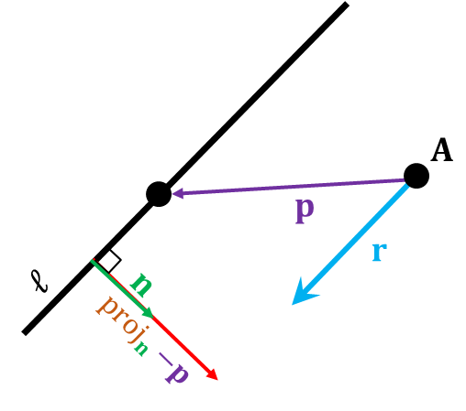






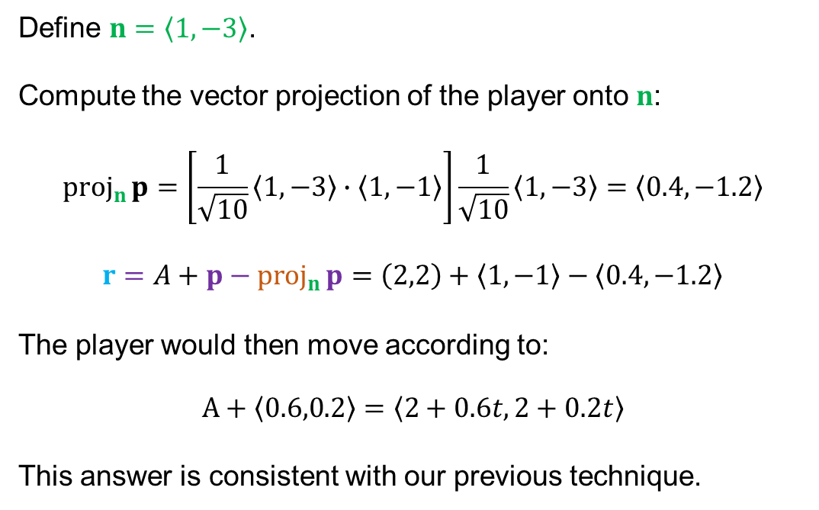
Wall Collision: Example (Revisited)
$$r=A+p+{proj}_{n}{−p}$$
Let $ℓ=\left\langle 3,1\right\rangle$ be a wall and $p$ be a player originating from a point $A=\left(2,2\right)$ in the direction of $\left\langle 1,−1\right\rangle$. Compute the parallel vector to the wall.
Solution.
Define $n=\left\langle 1,−3\right\rangle$.
Compute the vector projection of the player onto $n$:
$${proj}_{n}{p}=\left[\frac{1}{\sqrt{10}}\left\langle 1,−3\right\rangle ∙\left\langle 1,−1\right\rangle \right]\frac{1}{\sqrt{10}}\left\langle 1,−3\right\rangle =\left\langle 0.4,−1.2\right\rangle$$
$$r=A+p−{proj}_{n}{p}=\left(2,2\right)+\left\langle 1,−1\right\rangle −\left\langle 0.4,−1.2\right\rangle$$
The player would then move according to:
$$A+\left\langle 0.6,0.2\right\rangle =\left\langle 2+0.6t,2+0.2t\right\rangle$$
This answer is consistent with our previous technique.
$$ℓ$$
$$p$$
$$−{proj}_{n}{p}$$
$$n$$
$$p$$

Slide 15
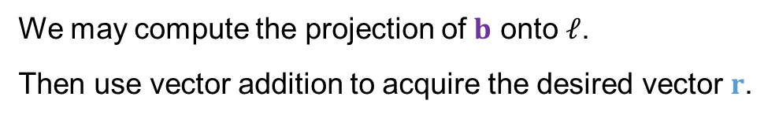

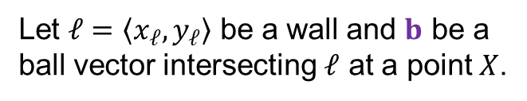
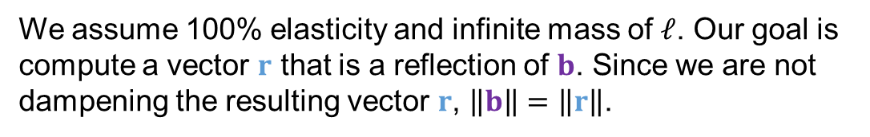










Application: Bouncing off a Wall
Imagine a ball hitting a completely elastic wall. In a perfect environment, the ball should bounce off with an angle of incidence $θ_{i}$ equating to the angle of reflection $θ_{r}$ measured with respect to a normal vector n to the wall.
Let $ℓ=\left\langle x_{ℓ},y_{ℓ}\right\rangle$ be a wall and $b$ be a ball vector intersecting $ℓ$ at a point $X$.
We assume 100% elasticity and infinite mass of $ℓ$. Our goal is compute a vector $r$ that is a reflection of $b$. Since we are not dampening the resulting vector $r$, $\left\|b\right\|=\left\|r\right\|$.
$${proj}_{ℓ}{b}$$
$$X$$
$$b$$
We may compute the projection of $b$ onto $ℓ$.
Then use vector addition to acquire the desired vector $r$.
$$θ_{i}$$
n
$${proj}_{ℓ}{b}$$
$$ℓ$$
$$θ_{r}$$
So $r=2{proj}_{ℓ}{b}−b$.
$${proj}_{ℓ}{b}$$
$$r$$
If we wish to dampen or enhance the elasticity, we can scale $r$ using some scalar $α$: $αr$.

Slide 16
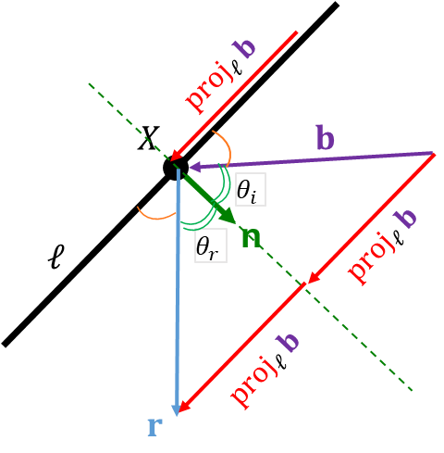
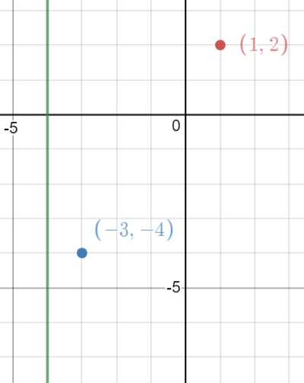

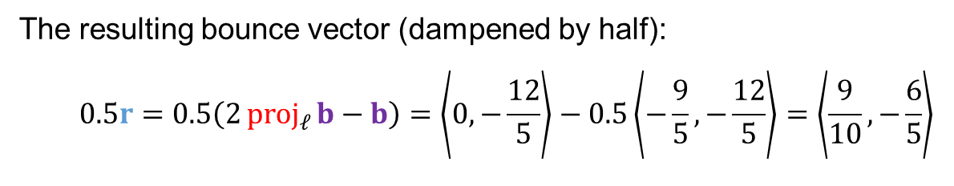
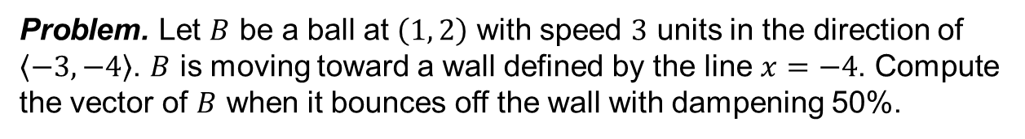






Bouncing off a Wall: Example
Problem. Let $B$ be a ball at $\left(1, 2\right)$ with speed $3$ units in the direction of $\left\langle −3, −4\right\rangle$. $B$ is moving toward a wall defined by the line $x=−4$. Compute the vector of $B$ when it bounces off the wall with dampening 50%.
$r=2{proj}_{ℓ}{b}−b$.
Solution.
We need to compute a vector, $ℓ$, corresponding to the wall; since the wall is vertical, we use a vertical, standard unit vector: $ℓ=\left\langle 0,1\right\rangle$.
$$ℓ=\left\langle 0,1\right\rangle$$
Compute vector $b$ representing the ball's movement (speed 3):
$$b=3⋅\frac{1}{\left\|\left\langle −3, −4\right\rangle \right\|}\left\langle −3, −4\right\rangle =3⋅\frac{1}{5}⋅\left\langle −3, −4\right\rangle =\left\langle −\frac{9}{5},−\frac{12}{5}\right\rangle$$
$${proj}_{ℓ}{b}$$
$$b$$
$$r$$
The projection of $b$ onto $ℓ$:${proj}_{ℓ}{b}=\frac{\left\langle 0,1\right\rangle }{1}∙\left\langle −\frac{9}{5},−\frac{12}{5}\right\rangle \frac{\left\langle 0,1\right\rangle }{1}=\left\langle 0,−\frac{12}{5}\right\rangle$
$$x=−4$$
The resulting bounce vector (dampened by half):
$$0.5r=0.5\left(2{proj}_{ℓ}{b}−b\right)=\left\langle 0,−\frac{12}{5}\right\rangle −0.5\left\langle −\frac{9}{5},−\frac{12}{5}\right\rangle =\left\langle \frac{9}{10},−\frac{6}{5}\right\rangle$$

Slide 17
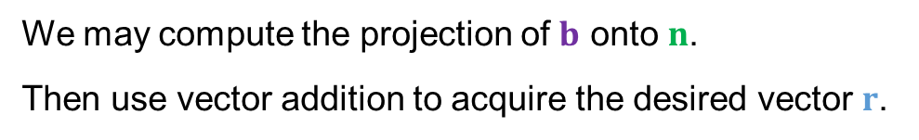




Bouncing off a Wall (Revisited)
Imagine a ball hitting a completely elastic wall. In a perfect environment, the ball should bounce off with an angle of incidence $θ_{i}$ equating to the angle of reflection $θ_{r}$ measured with respect to a normal vector n to the wall.
Let $ℓ=\left\langle x_{ℓ},y_{ℓ}\right\rangle$ be a wall and $b$ be a ball vector intersecting $ℓ$ at a point $X$.
We assume 100% elasticity and infinite mass of $ℓ$. Our goal is compute a vector $r$ that is a reflection of $b$. Since we are not dampening the resulting vector $r$, $\left\|b\right\|=\left\|r\right\|$.
$$X$$
$$b$$
We may compute the projection of $b$ onto $n$.
Then use vector addition to acquire the desired vector $r$.
n
$$θ_{i}$$
$$ℓ$$
$$θ_{r}$$
$${proj}_{n}{b}$$
So $r=−b+2\left(b−2{proj}_{n}{b}\right)=2b−b+2{proj}_{n}{b}=b−2{proj}_{n}{b}$.
$$b−{proj}_{n}{b}$$
$r=b−2{proj}_{n}{b}$.
$$r$$

Slide 18
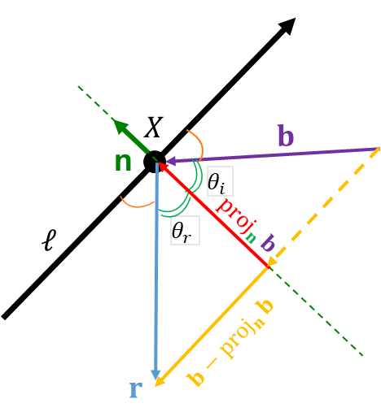
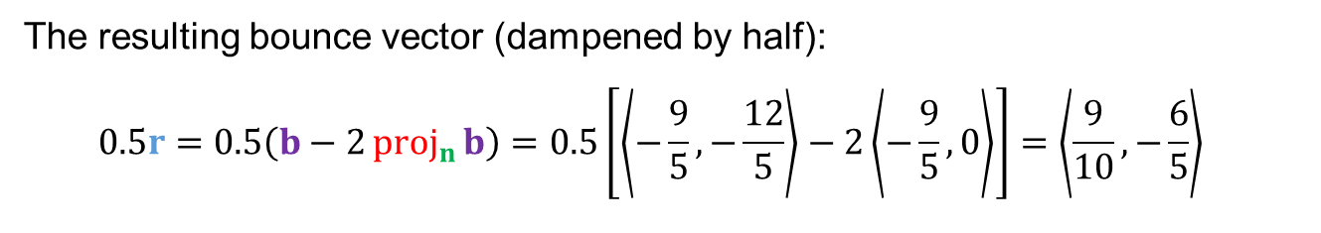





Bouncing off a Wall: Example (Revisited)
Problem. Let $B$ be a ball at $\left(1, 2\right)$ with speed $3$ units in the direction of $\left\langle −3, −4\right\rangle$. $B$ is moving toward a wall defined by the line $x=−4$. Compute the vector of $B$ when it bounces off the wall with dampening 50%.
$$r=b−2{proj}_{n}{b}$$
Solution.
Compute a normal vector $n$ to $ℓ$. Let $n=\left\langle 1,0\right\rangle$.
$$n$$
We have vector $b$ representing the ball's movement (speed 3):
$$b=3\frac{1}{\left\|\left\langle −3, −4\right\rangle \right\|}\left\langle −3, −4\right\rangle =\left\langle −\frac{9}{5},−\frac{12}{5}\right\rangle$$
$$ℓ=\left\langle 0,1\right\rangle$$
$$b$$
$${proj}_{n}{b}$$
$$r$$
The projection of $b$ onto $n$:${proj}_{n}{b}=\frac{\left\langle 1,0\right\rangle }{1}∙\left\langle −\frac{9}{5},−\frac{12}{5}\right\rangle \frac{\left\langle 1,0\right\rangle }{1}=\left\langle −\frac{9}{5},0\right\rangle$.
The resulting bounce vector (dampened by half):
$$0.5r=0.5\left(b−2{proj}_{n}{b}\right)=0.5\left[\left\langle −\frac{9}{5},−\frac{12}{5}\right\rangle −2\left\langle −\frac{9}{5},0\right\rangle \right]=\left\langle \frac{9}{10},−\frac{6}{5}\right\rangle$$
$$x=−4$$
This answer is consistent with our previous technique.

